Slide 1
Statistics for Linguistics
Adam J.R. Tallman
2021-06-01

Slide 2
From last class
Causal inference
Confounds (forks, pipes)
Model selection
interactions

Slide 3
Today’s class
Confound (pipes, colliders)
Probability vs. Likelihood
Generalized linear models
Logistic regression
Final project draft is due July 13th

Slide 4
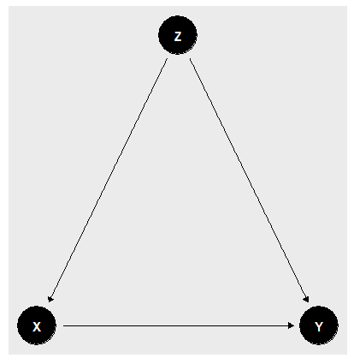
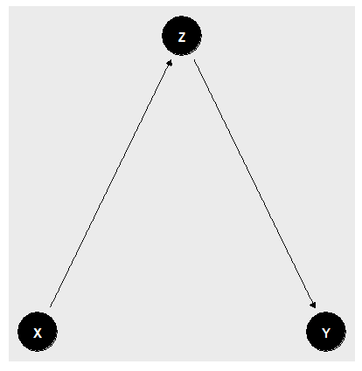

More confounds

Slide 5
The fork
You want to estimate the effect of X on Y, but the relationship is forked by another variable Z
What do you do?

Slide 6
The fork
You want to estimate the effect of X on Y, but the relationship is forked by another variable Z
What do you do?
Non-casual path

Slide 7
The fork
You want to estimate the effect of X on Y, but the relationship is forked by another variable Z
What do you do?
You condition on Z

Slide 8
The fork
You want to estimate the effect of X on Y, but the relationship is forked by another variable Z
What do you do?
You condition on Z
That means putting Z in as a
predictor in your model

Slide 9
The pipe
You want to estimate the relationship of X on Y, but the relationship is piped by Z.
What do you do?

Slide 10
The pipe
You want to estimate the relationship of X on Y, but the relationship is piped by Z.
What do you do?
If your question is how a change in X will influence a change in Y, then notihing
You do not want to add variables that block off causal pathways

Slide 11
The pipe
Let’s try a simulation

Slide 12
The collider
We want to assess the relationship of X on Y, and both X and Y cause Z.
Should we condition on Z?

Slide 13
The collider
We want to assess the relationship of X on Y, and both X and Y cause Z.
Should we condition on Z?
This is the most counterintuitive confound
So let’s illustrate.

Slide 14
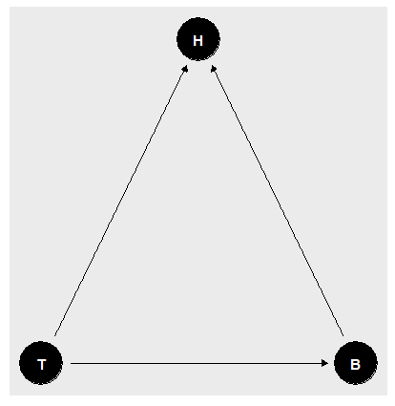
The collider
Let’s say you are interested in the relationship between a loss of taste and back pain.
You think that a loss of taste might be a proxy for covid for instance, and you want to see, the effect of covid on back pain.
But you can only observe patients in a hospital.

Slide 15
The collider
T = Loss of taste sensation
B = backpain
H = hospitalization
We know that more people go to the hospital if they have a loss of taste
We know that more people go to the hospital if they have backpain

Slide 16
The collider
Let’s simulate this
But imagine you can only observe people in a hospital
set.seed(115)
n <- 1000
notaste <- rnorm(n)
backpain <- rnorm(n)
p <- 0.2 #proportion of people who go to hospital
z <- notaste + backpain + rnorm(n) #measure of overall discomfort
q <- quantile(z, 1-p)
h <- ifelse(z>=q, TRUE, FALSE)
model.hospital <- lm(backpain[h]~notaste[h])
summary(model.hospital)

Slide 17
The collider
Should you conclude that covid cures back pain?
Call:
lm(formula = backpain[h] ~ notaste[h])
Residuals:
Min 1Q Median 3Q Max
-1.72670 -0.61173 -0.06442 0.52977 2.57790
Coefficients:
Estimate Std. Error t value Pr(>|t|)
(Intercept) 1.00764 0.08018 12.567 < 2e-16 ***
notaste[h] -0.37545 0.06579 -5.707 4.16e-08 ***
---
Signif. codes: 0 ‘***’ 0.001 ‘**’ 0.01 ‘*’ 0.05 ‘.’ 0.1 ‘ ’ 1
Residual standard error: 0.8355 on 198 degrees of freedom
Multiple R-squared: 0.1412, Adjusted R-squared: 0.1369
F-statistic: 32.57 on 1 and 198 DF, p-value: 4.157e-08

Slide 18
The collider
Let’s say you have access to data from people outside the hospital as well.
Should you include the hospital factor in your model?
model.collider <- lm(backpain~notaste+h)
summary(model.collider)

Slide 19
The collider
Call:
lm(formula = backpain ~ notaste + h)
Residuals:
Min 1Q Median 3Q Max
-2.95109 -0.59268 0.00274 0.55379 2.97088
Coefficients:
Estimate Std. Error t value Pr(>|t|)
(Intercept) -0.24049 0.03157 -7.617 6.00e-14 ***
notaste -0.23603 0.02998 -7.874 8.94e-15 ***
hTRUE 1.13326 0.07574 14.962 < 2e-16 ***
---
Signif. codes: 0 ‘***’ 0.001 ‘**’ 0.01 ‘*’ 0.05 ‘.’ 0.1 ‘ ’ 1
Residual standard error: 0.8832 on 997 degrees of freedom
Multiple R-squared: 0.1867, Adjusted R-squared: 0.1851
F-statistic: 114.5 on 2 and 997 DF, p-value: < 2.2e-16

Slide 20
The collider
You shouldn’t condition on a collider because it introduces a confound.
You should avoid designing research questions in such a way that you create collider biases as well.

Slide 21
In the real world
When scientists advocate more tests for people who show no symptoms or for people who are not hospitalized, they are generally worried about collider effects associated with hospitalization.

Slide 22
Causal inference
Take-away:
In later stages of research, don’t just throw lots of variables into a model – think about what you are doing in terms of causal structure.
Statistical inference depends on a causal model.
Next week we’ll look at the last confound (the descendent)

Slide 23
Generalized linear models

Slide 24
Generalized linear models
Up until now we have been using OLS (ordinary least squares) regression.
A more powerful tool is a generalized linear model
Generalized linear models use Maximum Likelihood Estimation (MLE) in order to get their parameters.

Slide 25
Generalized linear models
Likelihood and maximum likelihood simulation exercise

Slide 26
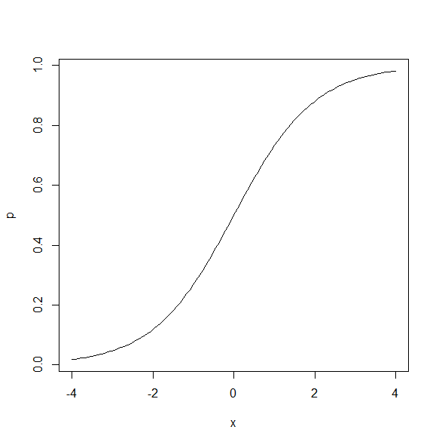
Logistic regression

Slide 27
Logistic regression
Logistic regression is a method for modelling binary data.
The basic ideas can be extended to non-binary data as long as they are organized into levels.
It is typically used when the dependent variable is binary and there is an interest in knowing how a change in x effects the probability that something is y.

Slide 28
Logistic regression (typical uses)
Psycholinguistic experiments where subjects have to give yes or no answers.
Various uses in natural language processing
Predict the risk of developing a specific disease.
Predict probability that someone will vote for a particular political party

Slide 29

Logistic regression
A logistic regression or logit model can be represented with the following equation.

Slide 30
Odds,log odds, oddrs ratios and log odds ratios
Odds: simple ration of the probability of one event to the probability of another evento (frequency of a / frequency b) are the odds of a over b.
Log odds: Logarithmically transformed odds
Odds ratio: ratio of two odds
Log odds ratio: Logarithmically transformed log odds

Slide 31
Logistic regression
Y Is bounded to 0 or 1
The relationship between x and y has a ceiling effect (like logarithms)
Let’s run a simulation model to get the feel for it.

Slide 32
Two causative constructions in Dutch
Doen relates to direct causation
Laten relates to indirect causation
(1) Hij deed me denken aan mijn vader
He did me think at my father
‘He reminded me of my father.’
(2) Ik liet hem mijn huis schilderen
I let him my house Paint
‘I had him paint my house.’

Slide 33
Homework and reading
Chapter 11 and 12 of Levshina (2016)
Chapter 7 Baayen (2008)
Please finish homework!
Next lecture:
Interpreting logistic regression
The descendent confound
Hierarchical models

